Slide 1




Rural Broadband Availability and Adoption: Evidence, Policy Challenges, and Options
Brian Whitacre, Oklahoma State University
Roberto Gallardo, Mississippi State University
Sharon Strover, University of Texas
March 18th, 2013

Slide 2

Webinar Content
Data utilized
Nature and extent of the metro – non-metro broadband digital divide
Factors that strengthen or impede broadband adoption in rural areas
Broadband’s contribution to economic health in rural areas
Policy options & discussion

Slide 3
Definitions
Metro / Micro / Noncore Counties
  Metropolitan: Urban core of ≥ 50,000 (or 25% of workforce commutes to an urban core)
  Micro: Urban core of 10,000 – 49,999 (or 25% of workforce commutes to an urban core of that size)
  Noncore: The rest
Broadband
  Current: 4 mbps Down, 1 mbps Up
  Historical: 200 kbps in at least 1 direction
  Various thresholds used depending on data sources
Nonmetro

Slide 4
Data Used
Current Population Survey – Internet use supplement
  Years: 2003, 2010 (most current)
  40,000+ observations (10,000+ non-metro); household-level
  Only differentiates between metro / non-metro (no county ID)
FCC County-level broadband adoption data
  Years: 2008,2010, and 2011 (most current)
  3,000+ counties
    671 micropolitan
    1,366 non-core
National Broadband Map – Neighborhood level
  Years: 2010, 2011
  3,000+ counties
    Aggregated to county-level
We mesh adoption data with availability data

Slide 5
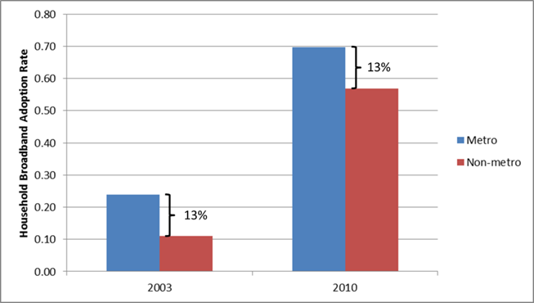
Metro Vs. Non-Metro
Broadband Divide
Metro – Non-metro Gap consistent since 2003
Household Broadband Adoption Rates by Metro/NM Status, 2003 and 2010
Source: Current Population Survey Internet Use Supplement, 2003 & 2010

Slide 6
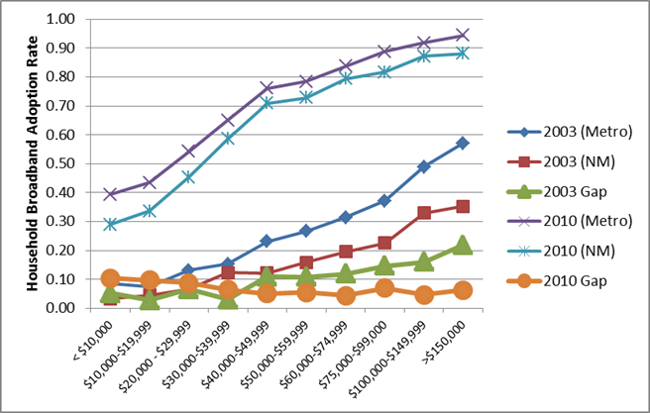
Metro Vs. Non-Metro
Broadband Divide
Metro – Non-metro Gap higher in 2010 for lower income levels
Household Broadband Adoption Rates by Income, 2003 and 2010
Source: Current Population Survey Internet Use Supplement, 2003 & 2010

Slide 7
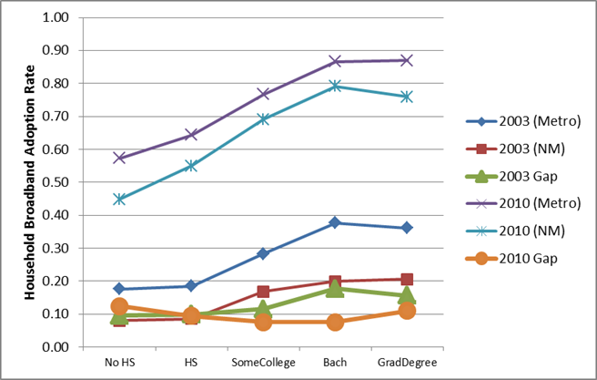
Metro Vs. Non-Metro
Broadband Divide
Metro – Non-metro Gap higher in 2010 for lower education levels
Household Broadband Adoption Rates by Education, 2003 and 2010
Source: Current Population Survey Internet Use Supplement, 2003 & 2010

Slide 8
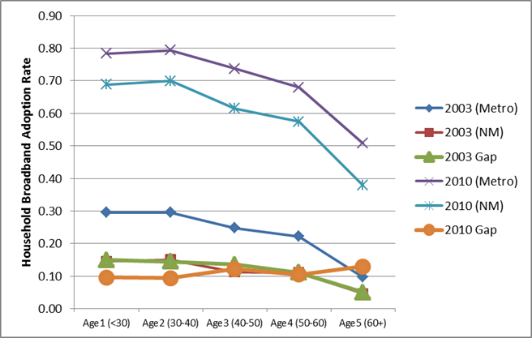
Metro Vs. Non-Metro
Broadband Divide
Metro – Non-metro Gap higher in 2010 for those over age 60
Household Broadband Adoption Rates by Age, 2003 and 2010
Source: Current Population Survey Internet Use Supplement, 2003 & 2010

Slide 9
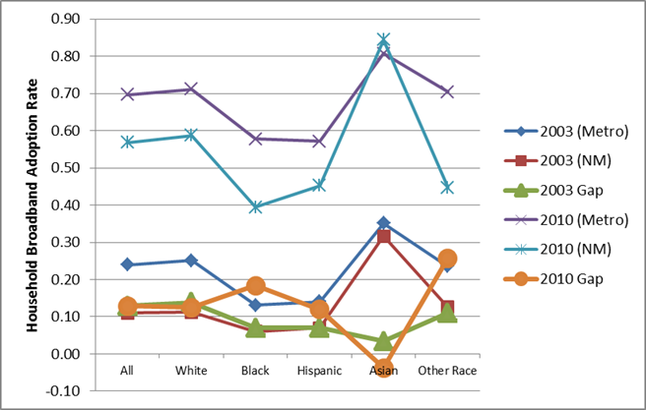
Metro Vs. Non-Metro
Broadband Divide
Metro – Non-metro Gap higher in 2010 for Blacks, Hispanics, Other race
Household Broadband Adoption Rates by Race, 2003 and 2010
Source: Current Population Survey Internet Use Supplement, 2003 & 2010

Slide 10
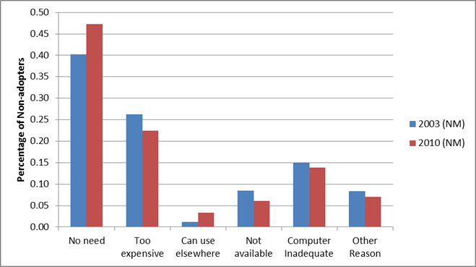
Metro Vs. Non-Metro
Broadband Divide
Primary Reason for Non-adoption of Broadband in NM Households, 2003 & 2010
Source: Current Population Survey Internet Use Supplement, 2003 & 2010

Slide 11
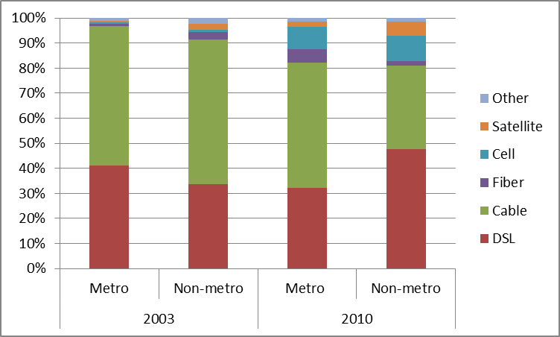
Metro Vs. Non-Metro
Broadband Divide
Composition of Residential Broadband Connections, 2003 & 2010
Source: Current Population Survey Internet Use Supplement, 2003 & 2010

Slide 12
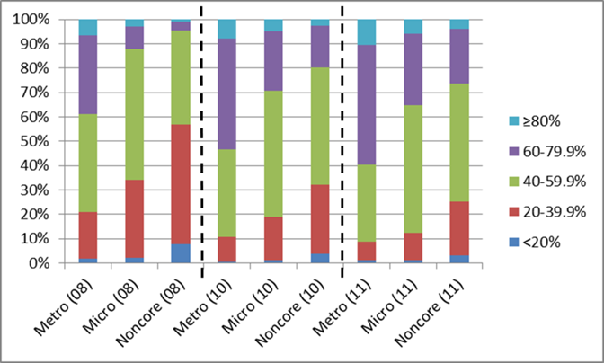
Metro Vs. Non-Metro
Broadband Divide
FCC Data: 5 Adoption categories
<20%
20-40%
40-60%
60-80%
>80%
County-level Broadband Adoption by Metro Status, 2008-2011
Source: FCC Form 477 Data

Slide 13
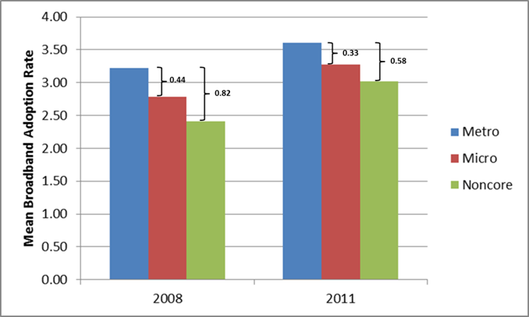
Metro Vs. Non-Metro
Broadband Divide
Metro – Micro , Metro – Non-core Gaps shrinking since 2008
County-level Broadband Adoption Gaps, 2008 and 2011
Source: FCC Form 477 Data

Slide 14
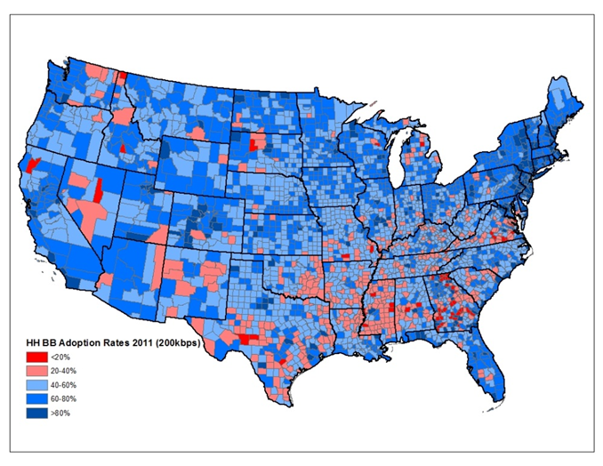
Metro Vs. Non-Metro
Broadband Divide
Pockets of low adoption exist…
County-level Household Broadband Adoption Rates, 2011
Source: FCC Form 477 Data
Notes:
- Pattern is similar when looking at education, age, race

Slide 15
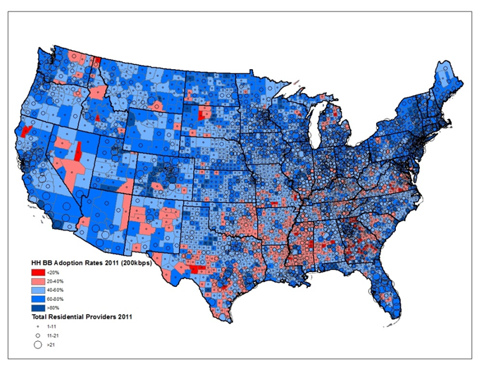
Metro Vs. Non-Metro
Broadband Divide
…but relationship with number of providers not overwhelming
County-level Household Broadband Adoption Rates and Number of Providers, 2011
Correlation Coefficients:
0.32 (all counties)
0.09 (non-core)
Source: FCC Form 477 Data
Notes:
- Pattern is similar when looking at education, age, race

Slide 16
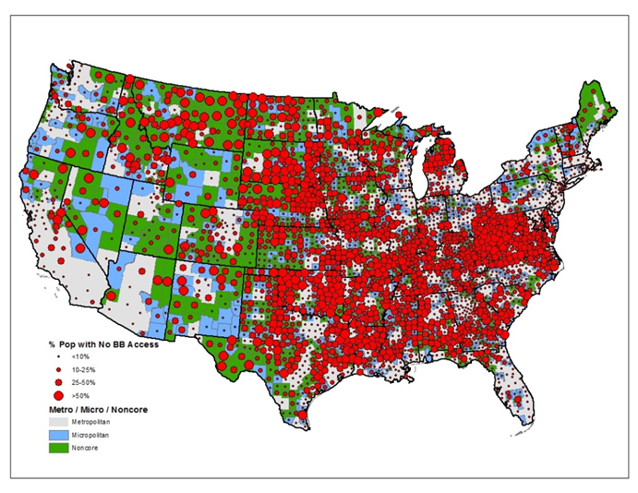
Metro Vs. Non-Metro
Broadband Divide
Pockets with High Levels of “No Broadband”
Percent of Population with No Broadband Availability, by Metro Status (2010)
One additional measure: % of population with no broadband available to them
Source: National Broadband Map Data (aggregated to County level)
Notes:
- Pattern is similar when looking at education, age, race

Slide 17
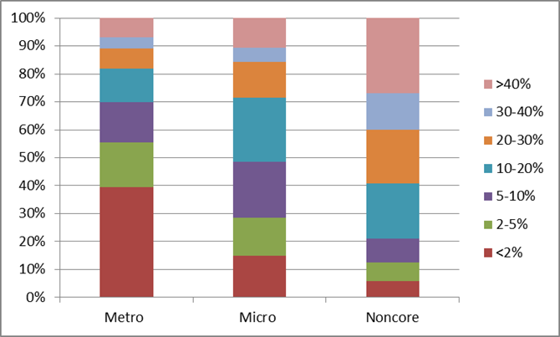
Metro Vs. Non-Metro
Broadband Divide
Many noncore counties with SIGNIFICANT (>40%) portions of their population lacking access to broadband
No Broadband Availability, by Metropolitan Status (2010)
Source: National Broadband Map Data (aggregated to County level)
Notes:
- Pattern is similar when looking at education, age, race

Slide 18
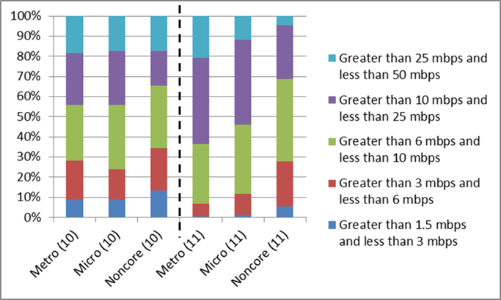
Metro Vs. Non-Metro
Broadband Divide: Download Speed
Average Max. Advertised Download Speed by Metro Status, 2010 & 2011
Source: National Broadband Map Data aggregated to County Level
Notes:
- Pattern is similar when looking at education, age, race

Slide 19
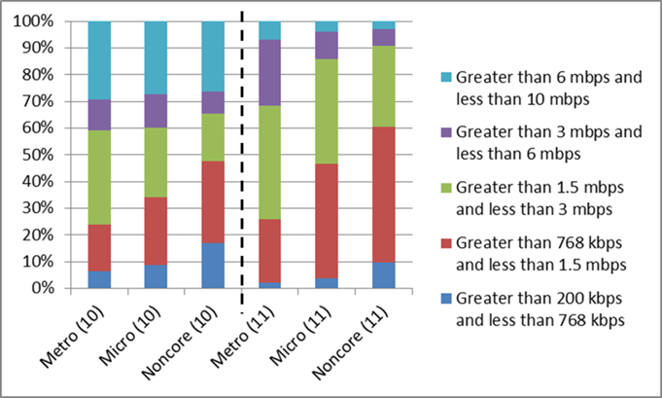
Metro Vs. Non-Metro
Broadband Divide: Upload Speed
Average Max. Advertised Upload Speed by Metro Status, 2010 & 2011
Source: National Broadband Map Data aggregated to County Level
Notes:
- Pattern is similar when looking at education, age, race

Slide 20
Factors Affecting Broadband
Adoption in Rural Areas
What Impacts Household Broadband Adoption? (CPS Data)
+ Impact: income, education, home business, Internet at work
- Impact: race / ethnic categories (Black, Hispanic), non-metro status
Availability Measures Impacting Adoption
+ Impact: Hi Availability (<15% No BB)
- Impact: Low # Providers (<3)
No Statistical Impact
Low / Hi Download speeds
Low / Hi Upload speeds
Hi # of Providers
Notes:
- Did not mention results comparing 2003 and 2010 due to the caution suggested by one of the reviewers

Slide 21
Factors Affecting Broadband
Adoption in Rural Areas
NM
Metro
2003: 11% 24%
2010: 57% 70%
What is Driving the Metro – Nonmetro Gap?
Broadband Adoption | Gap explained | Description
2003 | 47.3% (CD) 52.7% (PD) | Mainly due to characteristic differences (CD), specifically higher incomes/ educational levels in metro areas
2010 | 54.3% (CD) 45.7% (PD) | Parameter differences (PD) became a tad less relevant
2010 (Availability) | 89.9% (CD) 10.1% (PD) | Dramatic jump in explanatory power of characteristics differences (CD) when incorporating availability measure
Takeaway: If NM households were given the same characteristics as Metro households, ~50% of the BB Gap disappears.
If they also had the same levels of BB availability, 90% disappears!

Slide 22
Factors Affecting Broadband
Adoption in Rural Areas
NM
What is driving the increased adoption over time?
  Focus only on non-metro areas
2003: 11%
2010: 57%
Broadband Adoption | Gap explained | Description
2003-2010 | 4.5% (CD) 95.5% (PD) | Increase in non-metro adoption rate was due to shifting parameters -- likelihood of adopting for any income/educational level increased over time
This is predicted by diffusion theory: as broadband becomes more common, all types of households are more likely to adopt

Slide 23
Factors Affecting Broadband
Adoption in Rural Areas
What is Driving Broadband Adoption at the COUNTY Level? (FCC Data)
+ Impact: education, income, population, (though not in non-core counties); high concentrations of jobs in real estate / information
- Impact: share of non-farm proprietors, race / ethnic categories (only in non-core)
Availability Measures Impacting Adoption
2010
2011
High # Providers (>6)
Low # Providers (<3)
Low Download Speed (<3-6mbps)
High Download Speed (>10 mbps)
Low Download Speed (<3-6mbps)
Shift from # Providers to Download Speed

Slide 24
Factors Affecting Broadband
Adoption in Rural Areas
Explaining increasing county-level rates (2008 – 2011)
Significant % of counties increased their levels of BB adoption
+ Impact: higher population, higher income, more residential BB providers
- Impact: higher unemployment rates
Notes:
- Broadband providers data not included in table 13

Slide 25
Factors Affecting Broadband
Adoption in Rural Areas
Connected Nation Case Study: Pre/post study
  County-level data based on two (2) states that began after 2008 ; used Mahalanobis technique to match participating counties with otherwise similar non-participant counties
CN Participation (2008-09)
FCC Data (2008)
FCC Data (2011)
CN Non-participants
Participating counties did exhibit higher increases in the number of residential providers (particularly in noncore)
However, only metro counties saw higher increases in broadband adoption…micro counties were negative

Slide 26
Broadband’s Contribution to Economic Health in Rural Areas
3 Distinct Modeling Efforts
Cross-section Spatial Models
First-differenced Regression
Propensity Score Matching
Listed in order of increasing claims that can be made about causality
Adoption / Availability Measures to Test
(Measured in 2010)
Low % without BB Availability (<15%)
Hi download speeds (> 10 mbps)
Hi adoption rates (>60%)
Hi # providers (≥6)
High % without BB Availability (>35%)
Low download speeds (<3 mbps)
Low adoption rates (<40%)
Low # providers (≤3)
Economic Health Variables of Interest
(Typically measured in 2010)
% of employees classified as “creative class”
% of non-farm proprietors (self-employed)
Non-farm proprietor income
Median household income
% in poverty
Number of firms with paid employees
Total employed

Slide 27
Broadband’s Contribution to Economic Health in Rural Areas
Cross-section spatial models: 2010 Economic health indicators
  Population size, educational attainment, age groups, race/ethnicity, unemployment rate, metro status, and natural amenities were used as control variables; the broadband adoption/availability measures were our primary variables of interest
  Percentage of population without broadband and low number of providers impacted all (7) economic health indicators
  Increases in the percent population without access to broadband were associated with decreases in nonfarm proprietor average income, median household income, total firms with paid employees, and total employed
  All “high” broadband adoption/availability had a positive impact on total jobs and number of firms while all “low” indicators had a negative impact

Slide 28
Broadband’s Contribution to Economic Health in Rural Areas
First differenced regressions:
  Dependent Variable: 2008-2010 Change in Economic Health indicators
  Increases in broadband adoption had a positive impact on changes in median household income and total employment (analysis limited to non-metro counties)
    Particularly impressive – focuses on only recent adoption and over a short period of time
  No impacts on economic health indicators when using change in residential providers rather than broadband adoption

Slide 29
Broadband’s Contribution to Economic Health in Rural Areas
Propensity score matching: economic health indicators
  Compared treated (using broadband availability/adoption criteria) versus non-treated counties; matched based on their probabilities of reaching the broadband threshold
High levels of Broadband adoption (in non-metro counties) influenced economic growth increasing median household income and reducing poverty, unemployment
Low levels of Broadband adoption negatively impacted changes in number of firms, total employment, and unemployment rates
Broadband adoption thresholds impact economic health more than availability

Slide 30
In summary …Some gains, but lags remain
Using CPS household-level data, the broadband adoption gap between metro and non-metro areas remained at 13 percentage points in both 2003 and 2010; however this gap increased among low income, low education, and elderly
Using FCC county-level data, rural counties experienced a significant improvement regarding broadband adoption between 2008 and 2011
Logistic regressions showed traditional factors – income, education, age, race, and non-metro location – playing a role in adopting broadband between 2003 and 2010; low numbers of providers have a negative impact while higher levels of broadband availability have a positive impact

Slide 31
In summary …quality of service and employment effects
Regression models:
  **employment in specific industries (real estate and information sectors) as well as broadband speed have an impact on adoption rates
Connected Nation case studies:
  **positive results increasing the number of providers in rural counties, but no increase in broadband adoption
We found that low levels of adoption, providers, and broadband availability associated with lower median household income, higher levels of poverty, and decreased numbers of firms and total employment

Slide 32
In summary …economic impact
Statistical analysis showed that increases in broadband adoption between 2008 and 2010 resulted in higher levels of median household income and total employment (for non-metro counties)
Model results found that broadband adoption thresholds have more impact on changes in economic health indicators than broadband availability thresholds in non-metro counties between 2001 and 2010

Slide 33
Policy Options
Draw broadband infrastructure to less economically robust regions lacking broadband (FCC’s Connect America Fund, FCC Broadband Adoption Pilot Program incentives)
However, availability is not the entire solution
  Higher number of providers does not translate into increases in adoption, particularly in non-metro areas (Connected Nation case study)
The demand side – broadband adoption – must receive attention as well
Focus adoption programs on populations with lower levels of income and education as well as racial/ethnic minorities, also rural regions

Slide 34
Policy Options
Place-based differences have become less important over time (decomposition results)
  Limited exposure can depress peoples’ interest in broadband
  Policy implication: community anchor sites, highly public demonstrations of broadband’s potential
Build on diffusion factors such as trialability, observability, compatibility to expose non-adopters to the technology
Though wireless deployment is helpful, many of the productivity gains and economic advantages of broadband are limited through this technology
Support data gathering related to price / affordability (including bundles) and service quality (speed)

Slide 35
Some Light Reading…

