Slide 1
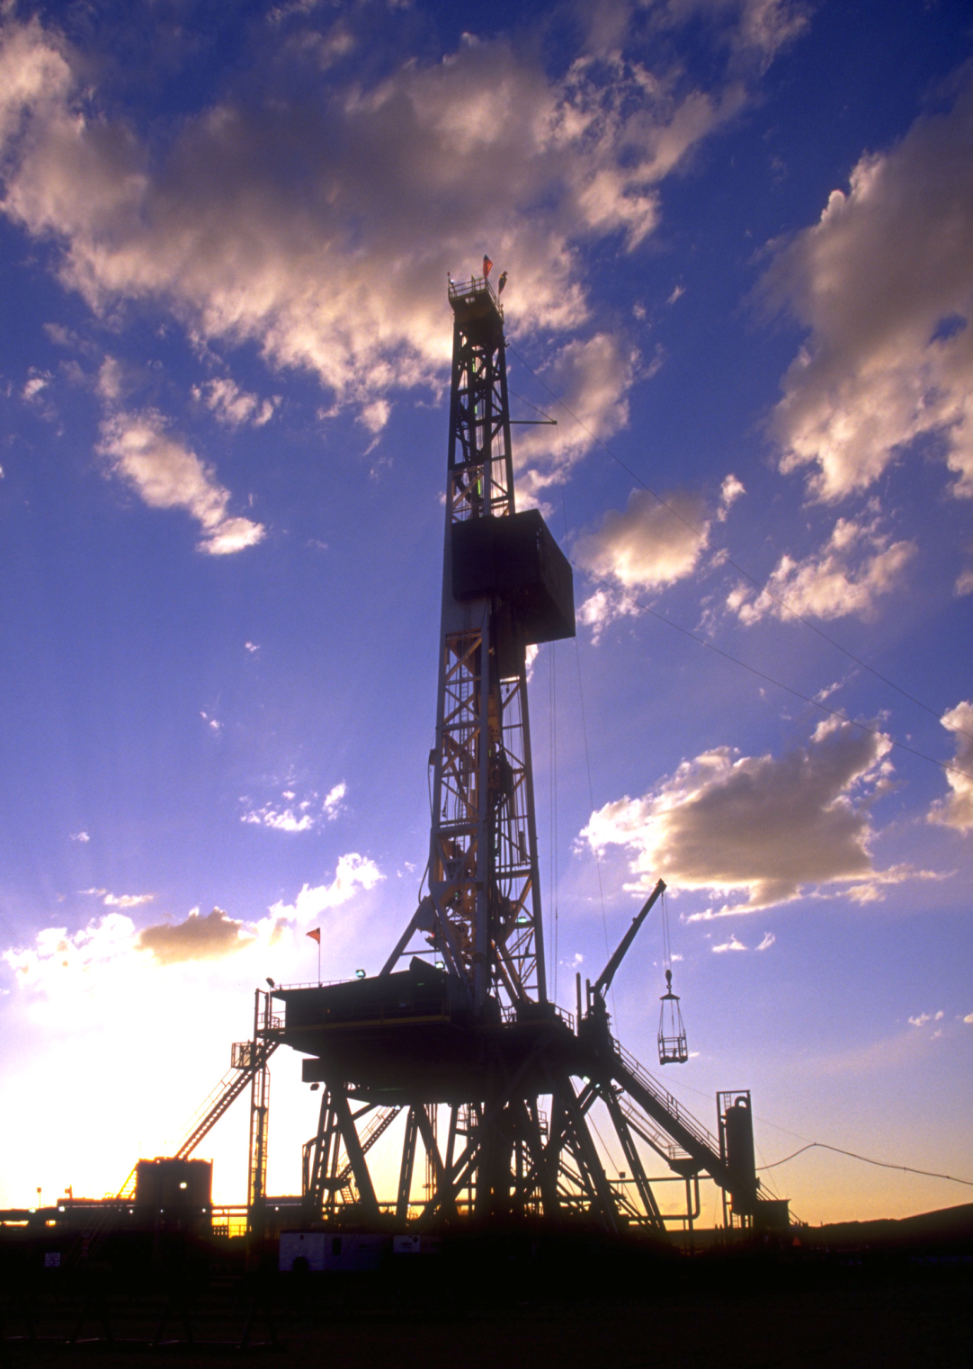

Natural Gas Extraction:
Issues and Policy Options
Presented by
Shannon L. Ferrell
Larry Sanders
Oklahoma State University
February 27, 2012

Slide 2
Overview
Background
Methods
Issues
Environmental
Framing
Policy Examples
Technical Foundation
Community
Options / Consequences
Status quo
More government involvement
Less government involvement
Notes:
Larry

Slide 3
Background
METHODS
TECHNICAL ASPECTS
OF HYDRAULIC FRACTURING
REVIEW
OF
LITERATURE
OPTIONS
&
CONSEQUENCES
MECHANICS OF FRACKING
BRIEF POLICY/ REGULATORY HISTORY
Notes:
Larry

Slide 4
Issues: Environmental
General Environmental
General concerns / insufficient information
Habitat fragmentation
Solid Waste
Disposal of drill cuttings / mud
Handling NORM wastes
Water
Quantity & source used
Air
Surface Spills
Impacts of injected fluid
Fluid component disclosure
Wastewater treatment
Well emissions
Equipment emissions
Flowback / produced water emissions
Liability Issues
Avoidance of liabilities by bankruptcy /dissolution
Notes:
Shannon

Slide 5
Issues: Community
Financing responses to NGE impacts
Generating revenue for gov’t functions
Allocation of revenues
Engaging community stakeholders
Need for planning / stakeholder engagement
Housing
Sociological impacts
Social isolation / community identity
Availability for workers
Accessibility for fixed- & low-income residents
Crime / fear of crime
Substance abuse
Sexual abuse / disease
Youth issues
Family stressors
Notes:
Shannon

Slide 6
Issues: Community
Education
Availability of facilities
Availability of staff
Workforce availability
Available workforce
Local worker suitability
Transportation infrastructure
Existing infrastructure repairs
Landowner impacts
Expansion of infrastructure
Visual impacts
Auditory impacts
Surface damages
Landowner / mineral negotiation
Worker skills
Notes:
Shannon

Slide 7
Framework
Quality of Life
Provides additional energy sources; maintains/enhances econ. dev.
How to extract natural gas resources
(thru hydraulic fracturing)
Protect / enhance the environment
Protect / enhance community well-being
Problem is role of government & responsibility of industry to provide the economic foundation for the preferred quality of life: getting it where, when, how much and at a price we want
Notes:
Shannon

Slide 8
MORE INVOLVEMENT
Higher NG price; supply instability
Air/water protection
Threat to economic development/jobs
Landowner profit opportunities less
Mitigation/public response to concerns funded by severance tax/mandated funds
Response alternatives and likely consequences
STATUS QUO
Low NG price
Water quality/quantity uncertainty
Local revenue issues to cover impacts
Economic development/jobs
Boom-bust issues
Landowner profit opportunities
Landowner adverse impacts
Other environmental issues
LESS INVOLVEMENT
Low/lower NG price; increased supply
More adverse environmental/community impacts likely
Less NG for future generations
Higher profit margin for industry
More economic development/jobs
Notes:
Shannon

Slide 9
Alternatives: Environmental
General Environmental
Moratoria
Increased research efforts
Solid Waste
Regulation under RCRA (remove exemption)
New NORM handling reqs
Water
Regulate quantity & source used
Air
Secondary containment reqs
Regulate fracking under SDWA UIC / well specs
Fluid component disclosure reqs
Increase/ expand treatment reqs
“Green” completion reqs
Equipment emissions limitations
Sealed vessel storage reqs
Liability Issues
Limit bankruptcy dischargeability of liabilities
Prohibit dissolution of entities w/ envir. liabilities

Slide 10
Alternatives: Community
Financing responses to NGE impacts
Ad valorem severance tax
Fixed (per unit) severance tax
Engaging community stakeholders
Education efforts for community leaders
Resource revenue trust funds
Voluntary mitigation funds
Revenue-sharing between governmental levels/units
Housing
Sociological impacts
Public deliberation forums
Community social events engaging current & new residents
Community-built housing
Developer-built housing
Facilitation of private housing development
Streamline housing approval / permit process
Voucher / subsidy programs for low- or fixed-income residents
Crime prevention through community engagement programs
On-site drug abuse prevention programs
Public-private partnerships to address sexual abuse / disease
Community programs for supportive youth environments
Domestic violence support / therapy programs
Notes:
Shannon

Slide 11
Alternatives: Community
Education
Temporary facilities
Alternative class schedules
Alternative schooling arrangements (online / homeschooling)
Workforce availability
Accelerated training programs
Public-private training partnerships
Transportation infrastructure
Posting vehicle weight limits
Landowner impacts
Well permit fees allocated to transportation systems
Road maintenance agreements
Visual impact mitigation
Auditory impact mitigation
Setbacks / siting requirements
Surface damage compensation requirements
Landowner / mineral owner education programs
Notes:
Shannon

Slide 12
Conclusions
Much uncertainty about natural gas extraction issues remains
All stakeholders have numerous options for action
Informed dialog among stakeholders at every level is critical
Notes:
Larry

Slide 13
Thanks! Contact information:
  shannon.ferrell@okstate.edu
larry.sanders@okstate.edu

